Slide 1
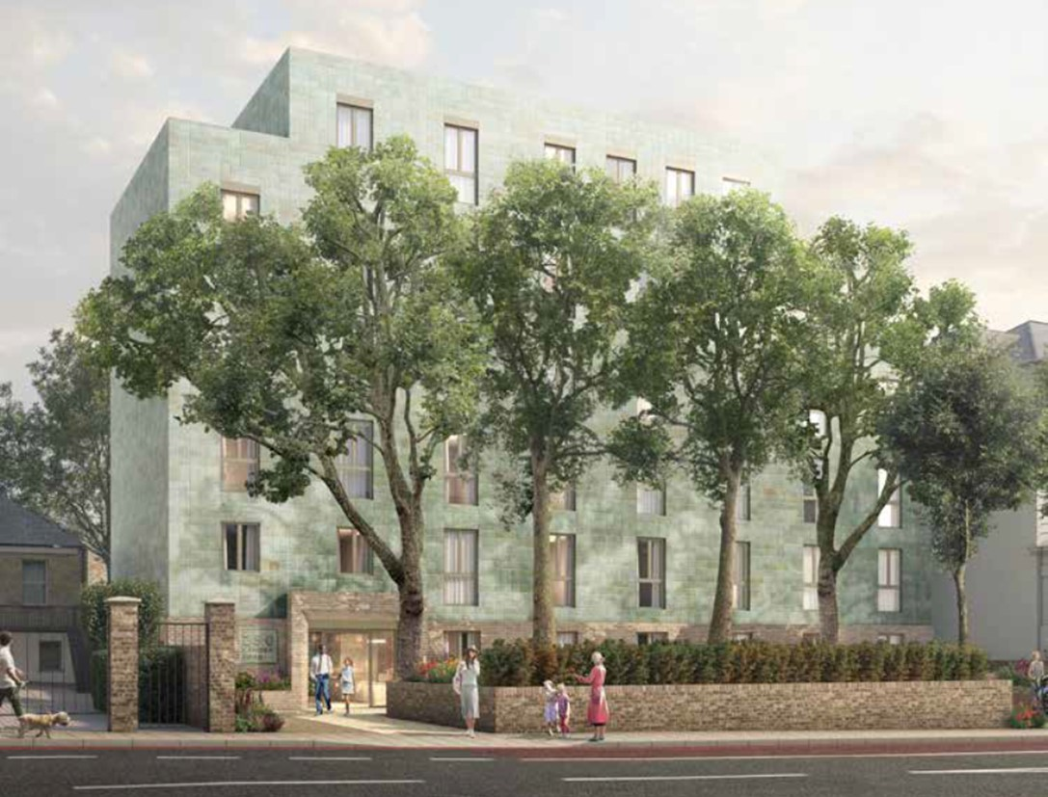
Camden Road
Lighting Workshop
November 2025
Notes:
Title cover 1

Slide 2
Key Points for Morgan Sindall Construction Lighting Design
Lighting design must provide safe access and egress for residents
Lights are dimmable
Lights can be programmed to dim down at certain times
Architectural layouts are fixed following planning permission and cannot be altered
We have already selected less invasive luminaires where possible. In the staircases we have changed to directional downlights to minimise light pollution to surrounding properties
Mesh on staircase to help dilute lighting pollution
Lighting design in accordance with ILP Guidance Note 01/21

Slide 3

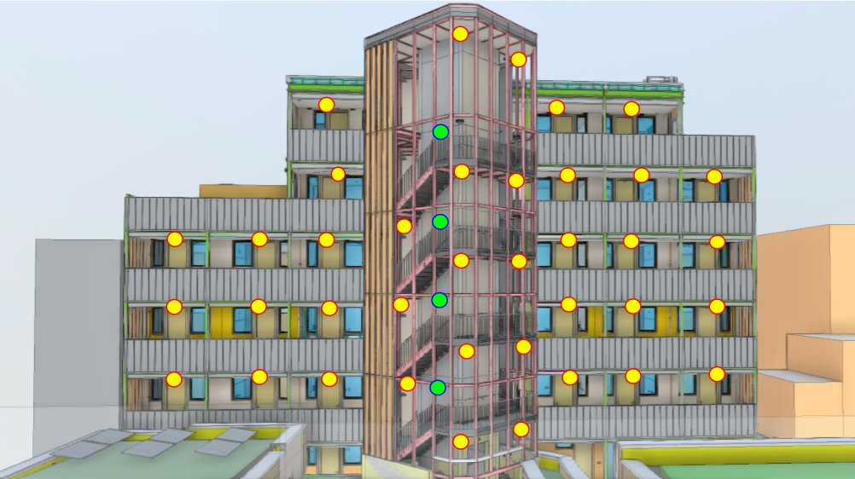
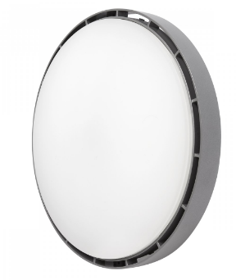

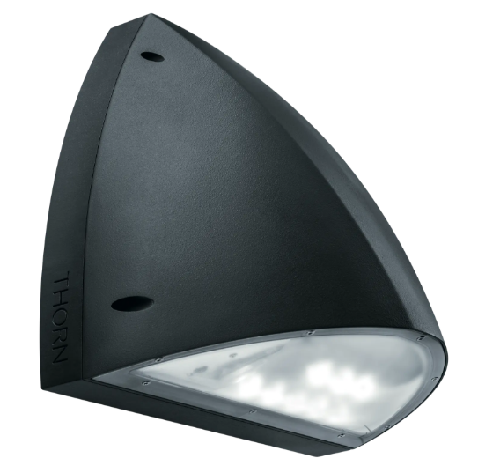
Camden Road – Rear View
Corridor / Stair Ceiling Mounted Light
Stair Wall Mounted Light
Note : These images provide an indication of lighting locations but are not an accurate representation of how the final building will look.

Slide 4
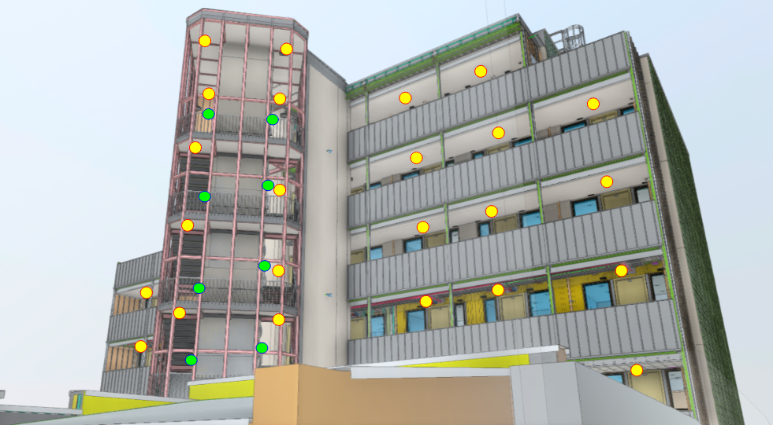
Camden Road – Angled View
Corridor Ceiling Mounted Light
Stair Wall Mounted Light
Note : These images provide an indication of lighting locations but are not an accurate representation of how the final building will look.

Slide 5
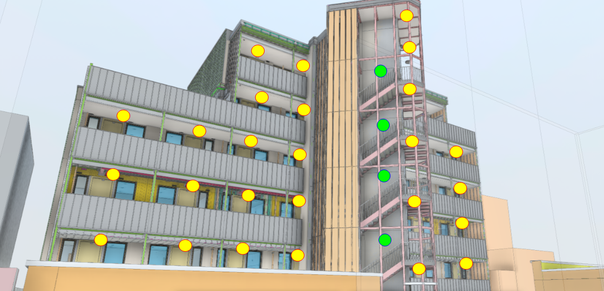
Camden Road – Angled View
Corridor Ceiling Mounted Light
Stair Wall Mounted Light
Note : These images provide an indication of lighting locations but are not an accurate representation of how the final building will look.

Slide 6
Options During Commissioning for General Lighting
During night hours/low light, lighting can be managed in one of 2 ways:
1.Lights can be kept at one level for the duration of the night/low light period. This will be as low as possible (levels to be agreed with Camden Team) to allow residents safe access and egress.
2.Lights can dim down to 10% brightness and upon detection of pedestrian increase to required levels for safe access and egress. After 5 minutes these would then dim back down to 10%.
Options for general lighting subject to Secured by Design and Camden Council approval
Emergency lighting levels will be set by regulatory requirements

Slide 7
Any Questions?

