Slide 1
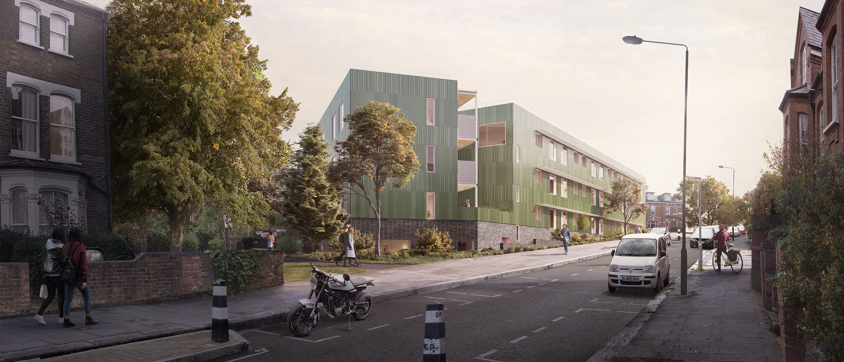
Morgan Sindall Construction
Chester Road
Construction Working Group Meeting – November 2025
Notes:
Title cover 2

Slide 2
Works completed in the period
Superstructure – The main structures of the blocks have now been built and topped out
Roof – Initial layer of waterproofing has been applied
Fitout – Fitout progressing on Level 01 of all three blocks, internal drylining and M&E install
Façade – The façade finishes are on going, following the window install. This includes brickwork, insulation and fire barriers,
Notes:
Vision, Values & Purpose - expanded

Slide 3
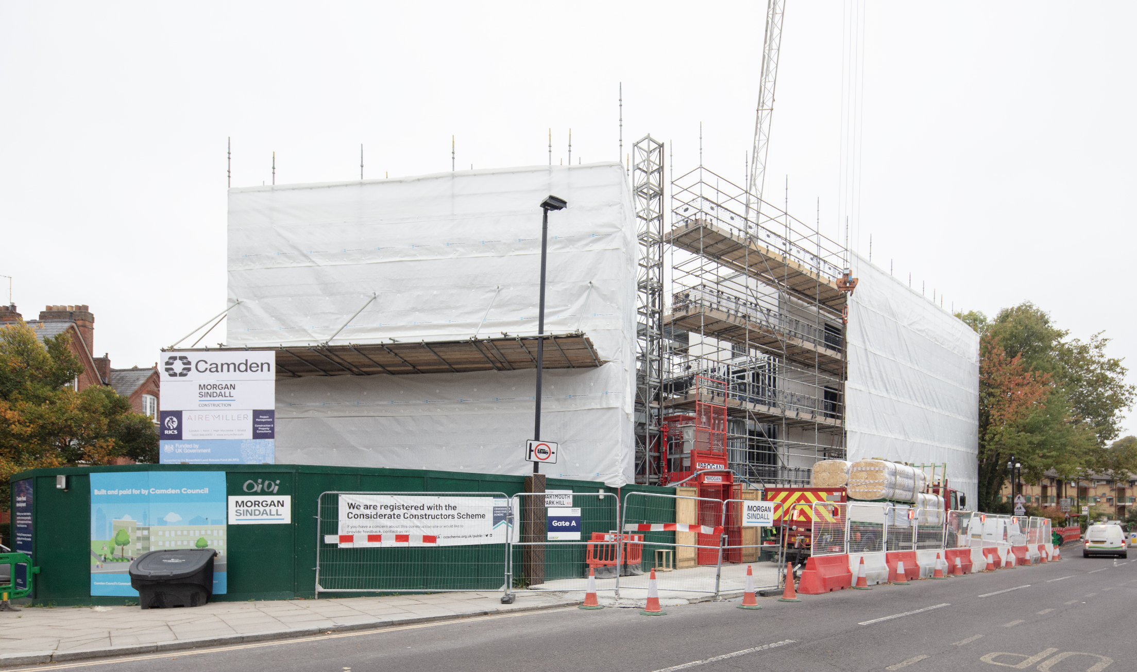
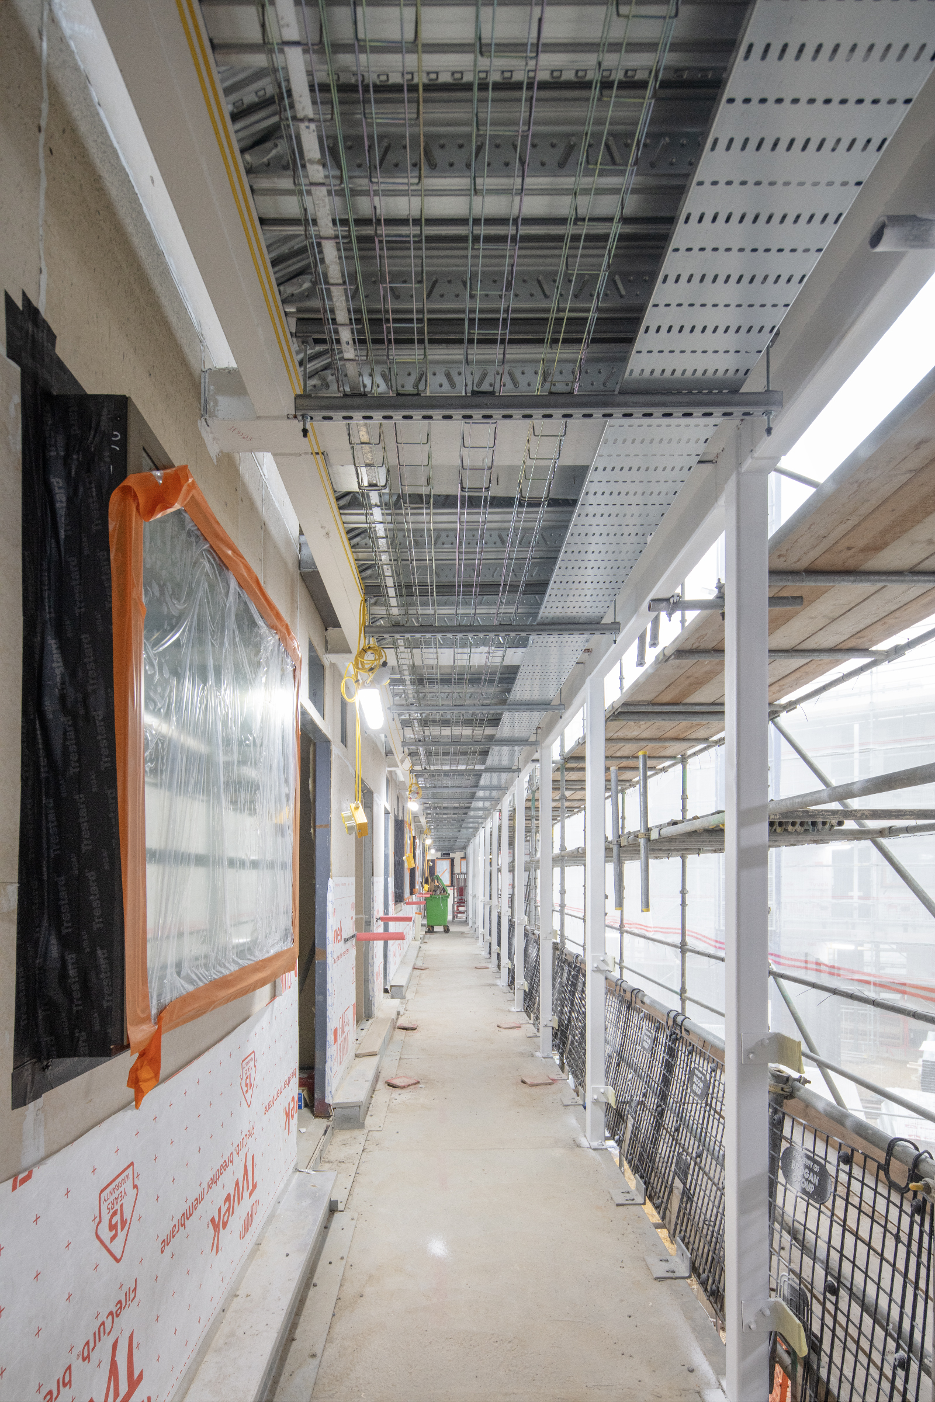
Progress On Site
View from Dartmouth Park Hill & Walkway Progress
Notes:
Vision, Values & Purpose - expanded

Slide 4
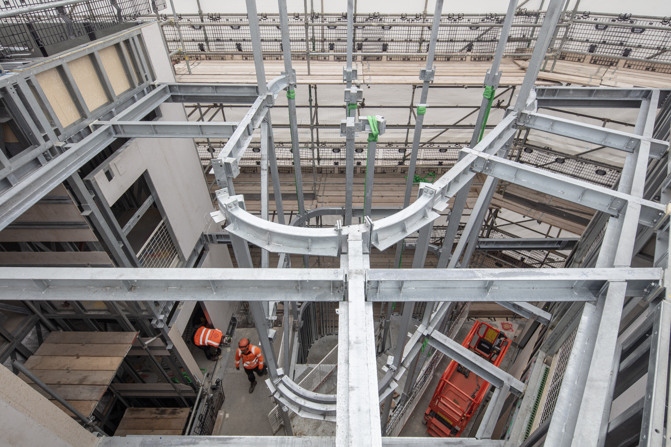
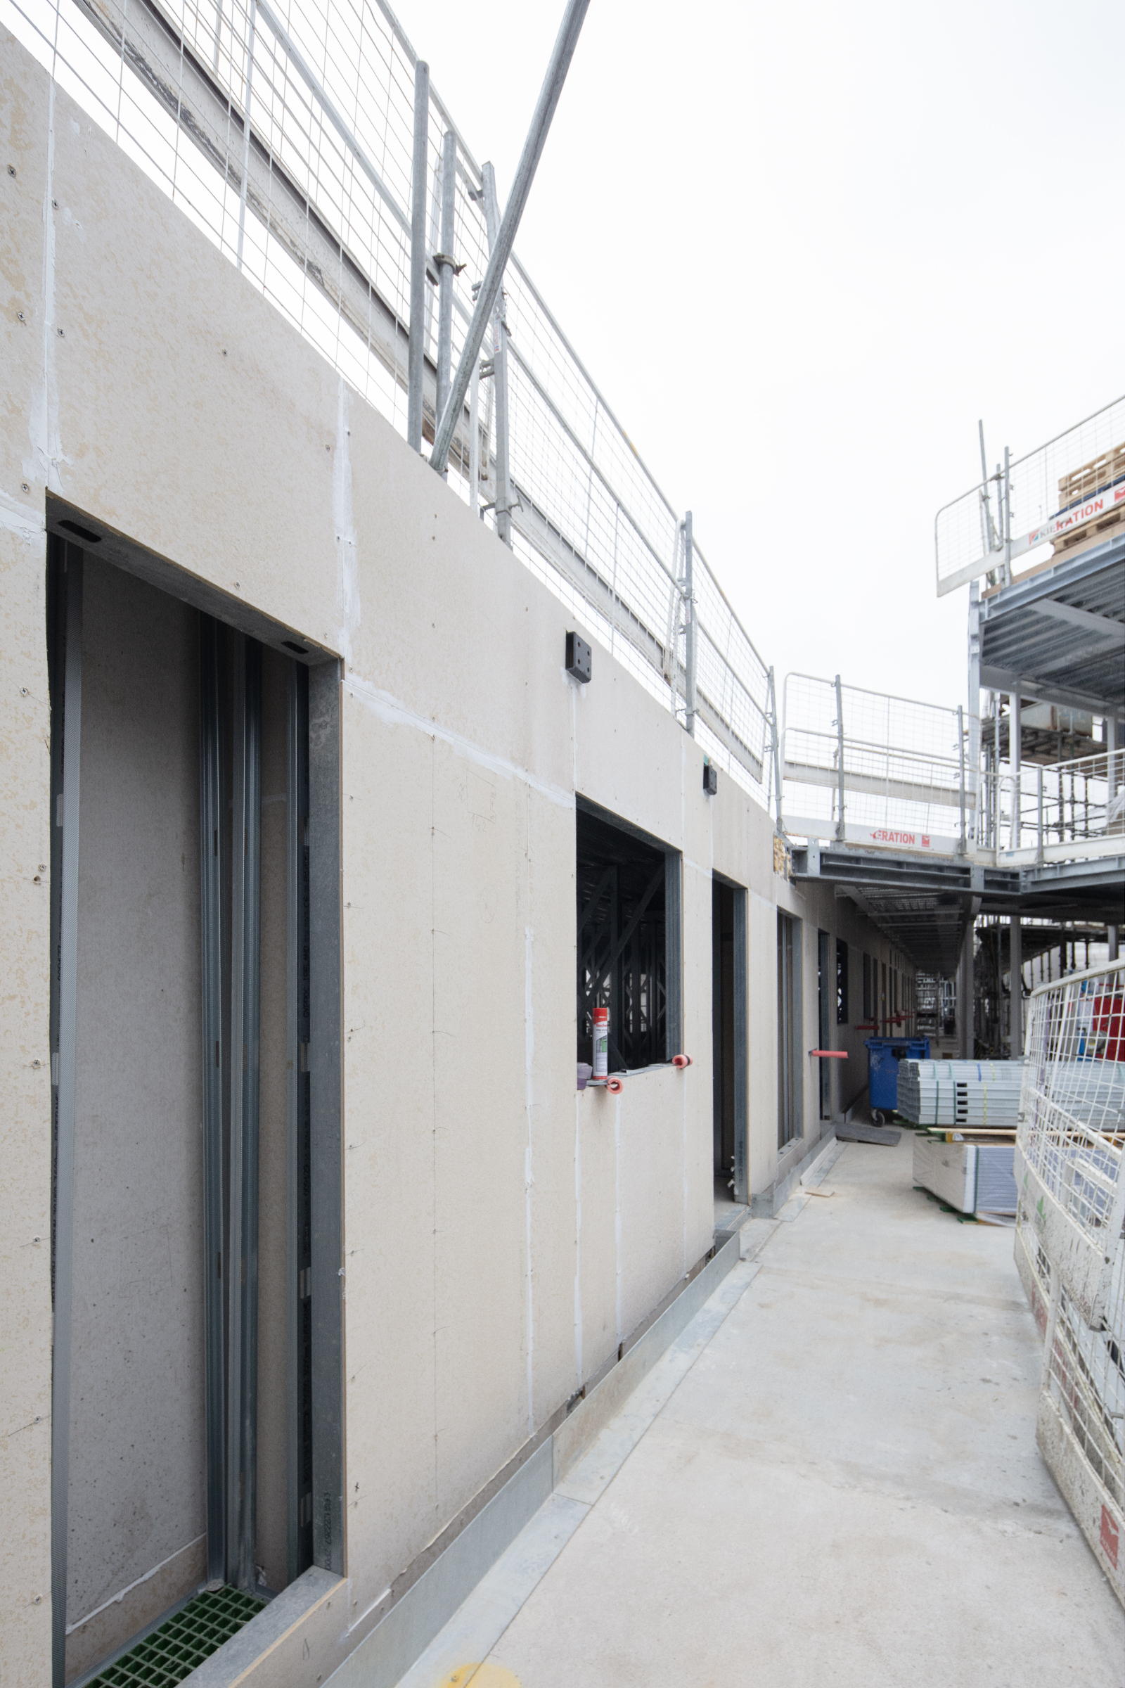
Progress On Site
Staircase & Walkway Progress
Notes:
Vision, Values & Purpose - expanded

Slide 5
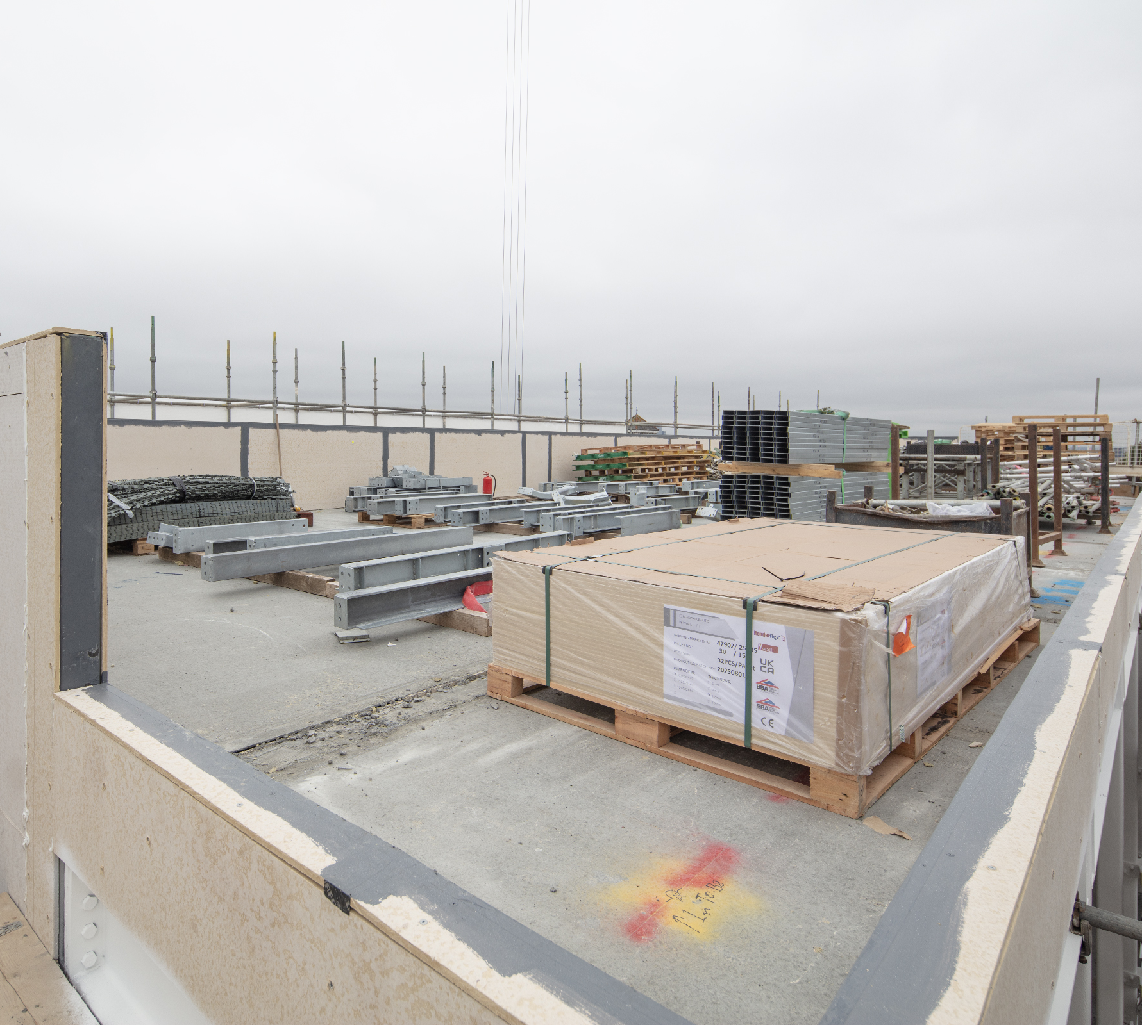
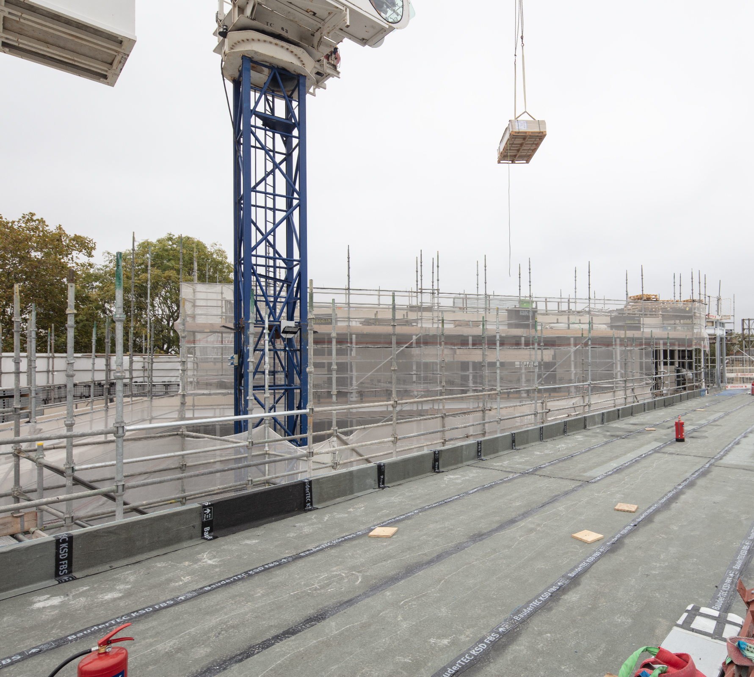
Progress On Site
Roof Progress
Notes:
Vision, Values & Purpose - expanded

Slide 6
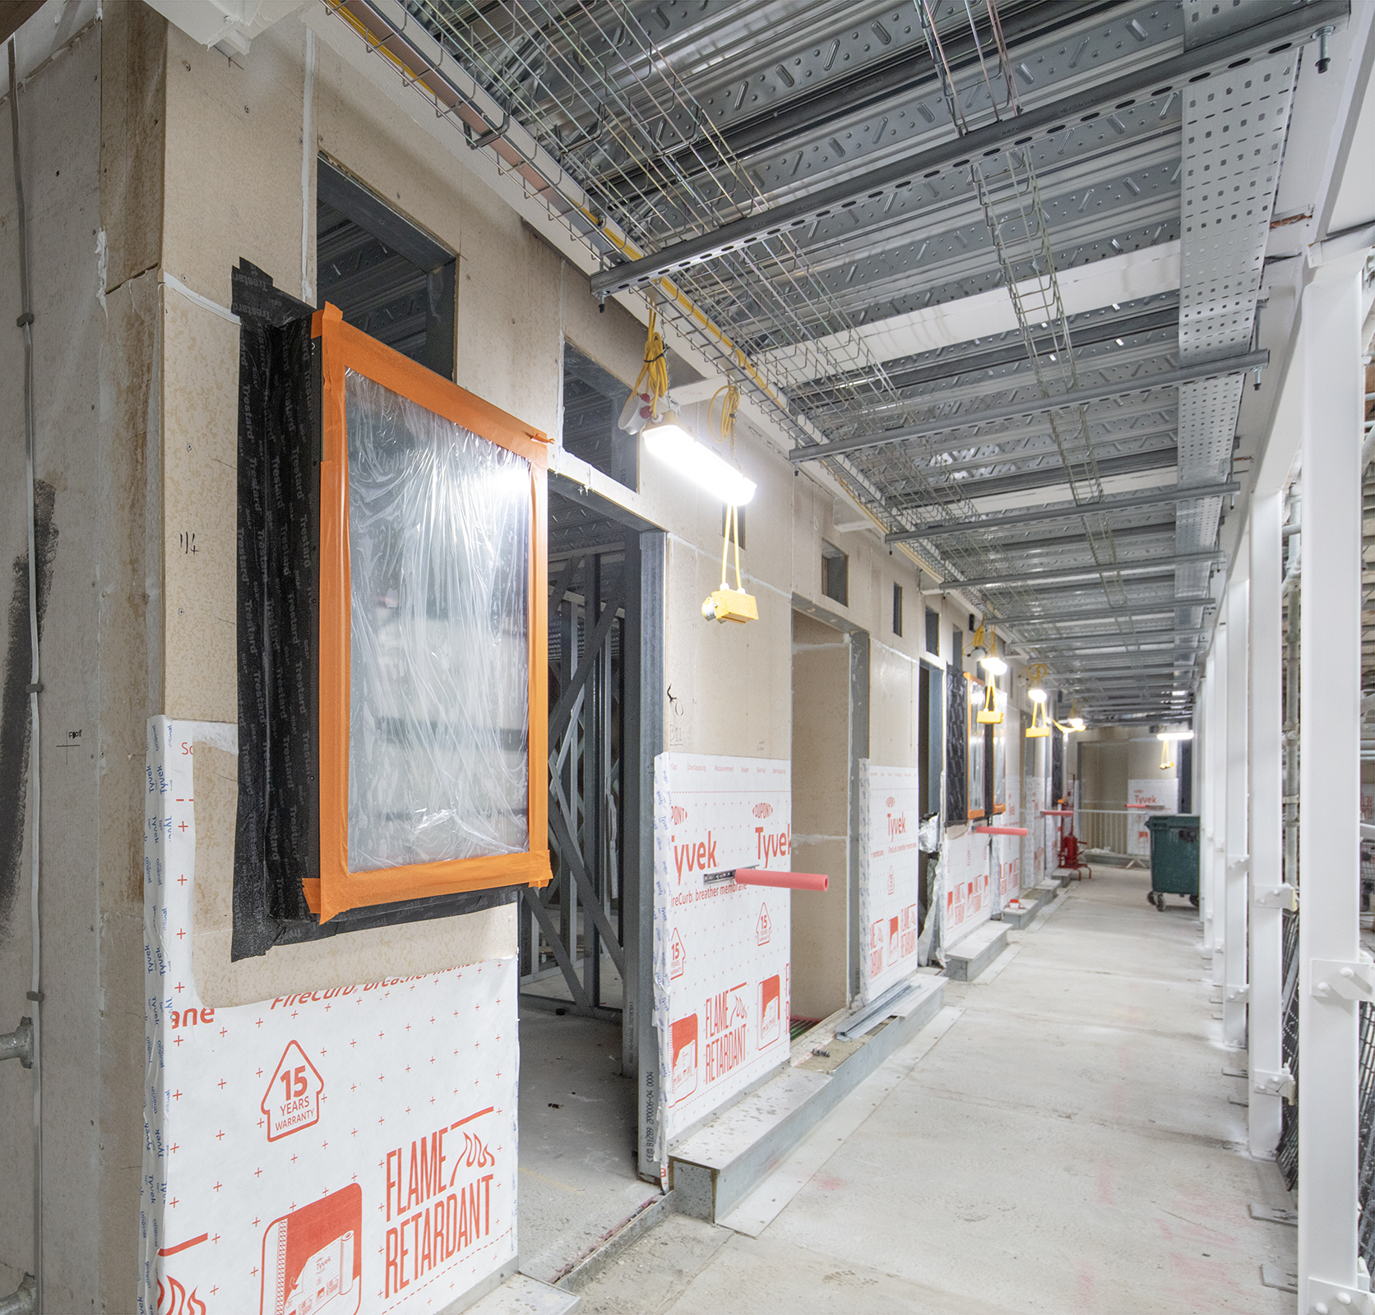
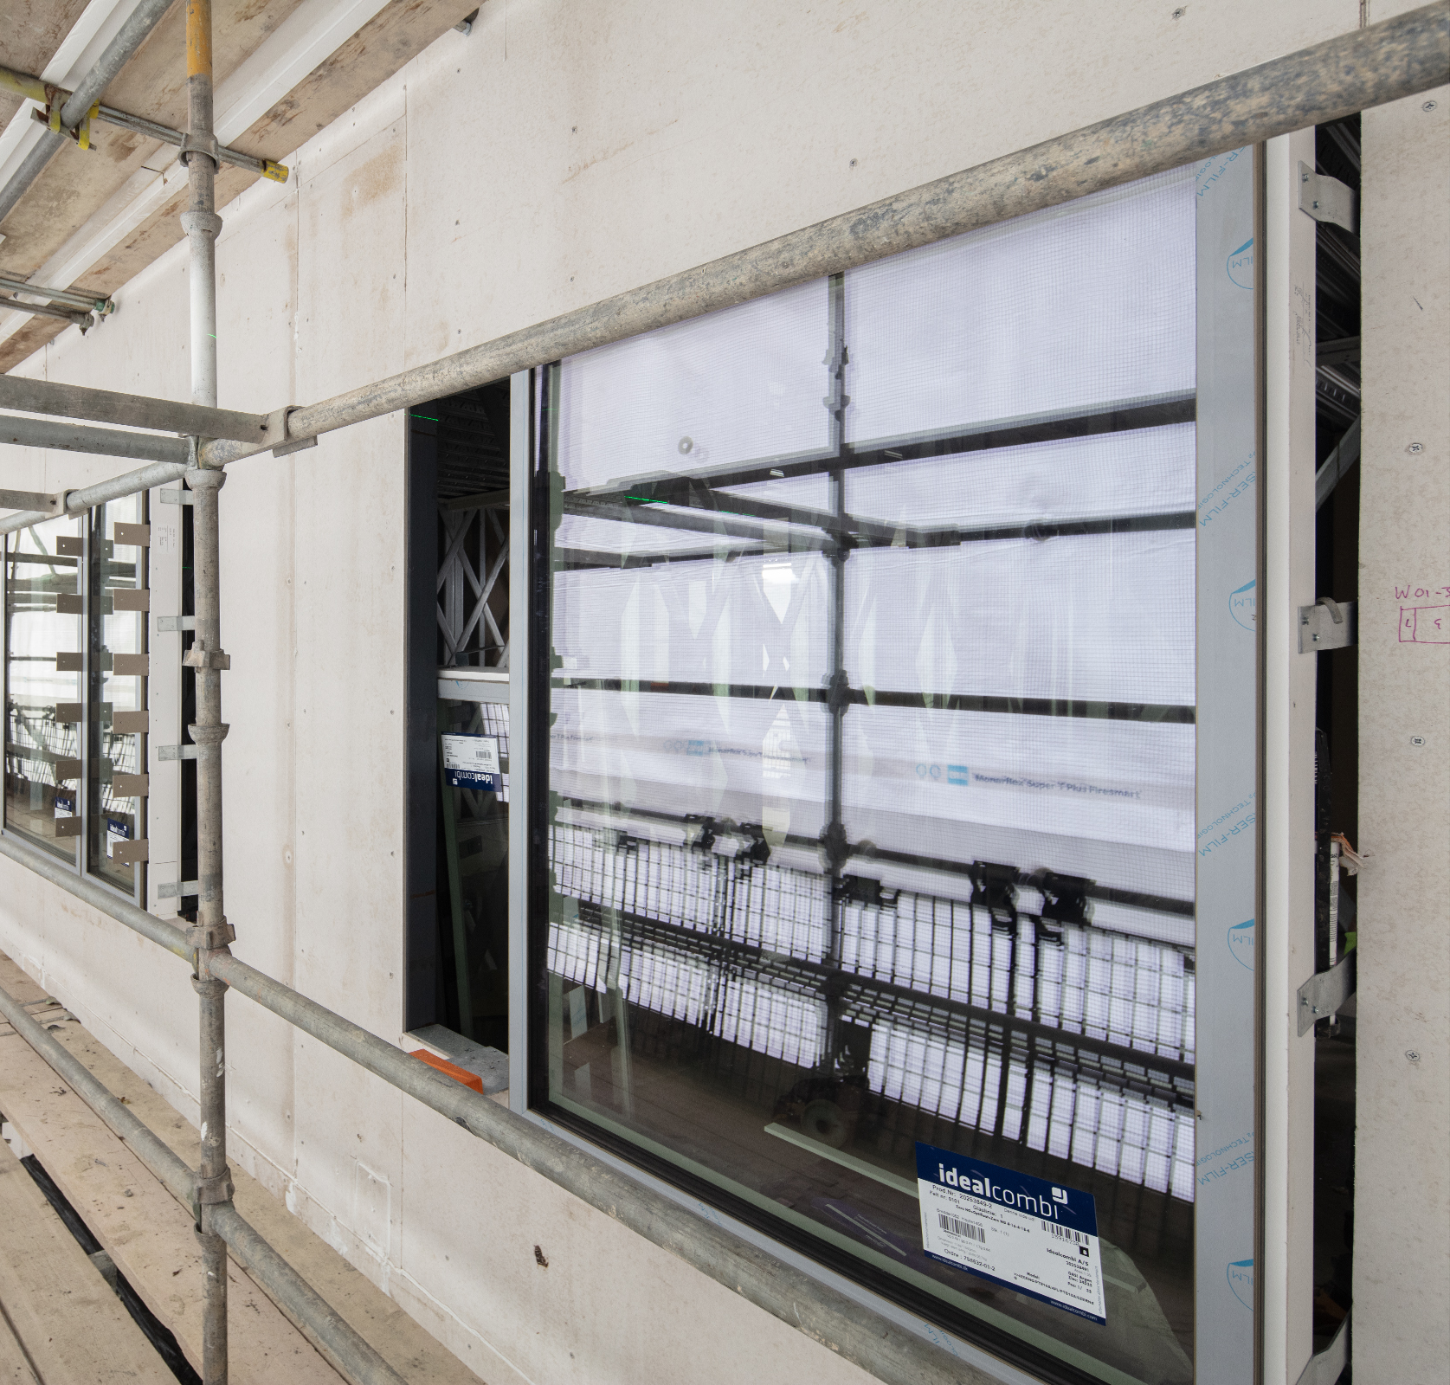
Progress On Site
Walkway & Window Progress
Notes:
Vision, Values & Purpose - expanded

Slide 7
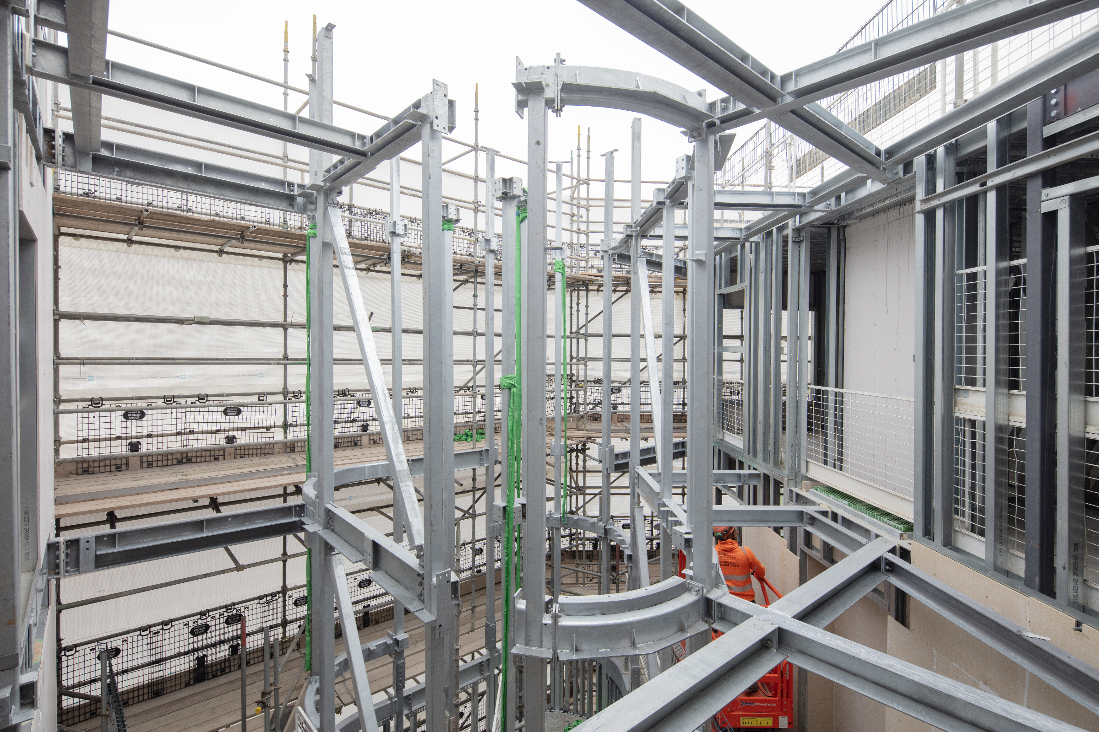
Progress On Site
Staircase Progress
Notes:
Vision, Values & Purpose - expanded

Slide 8
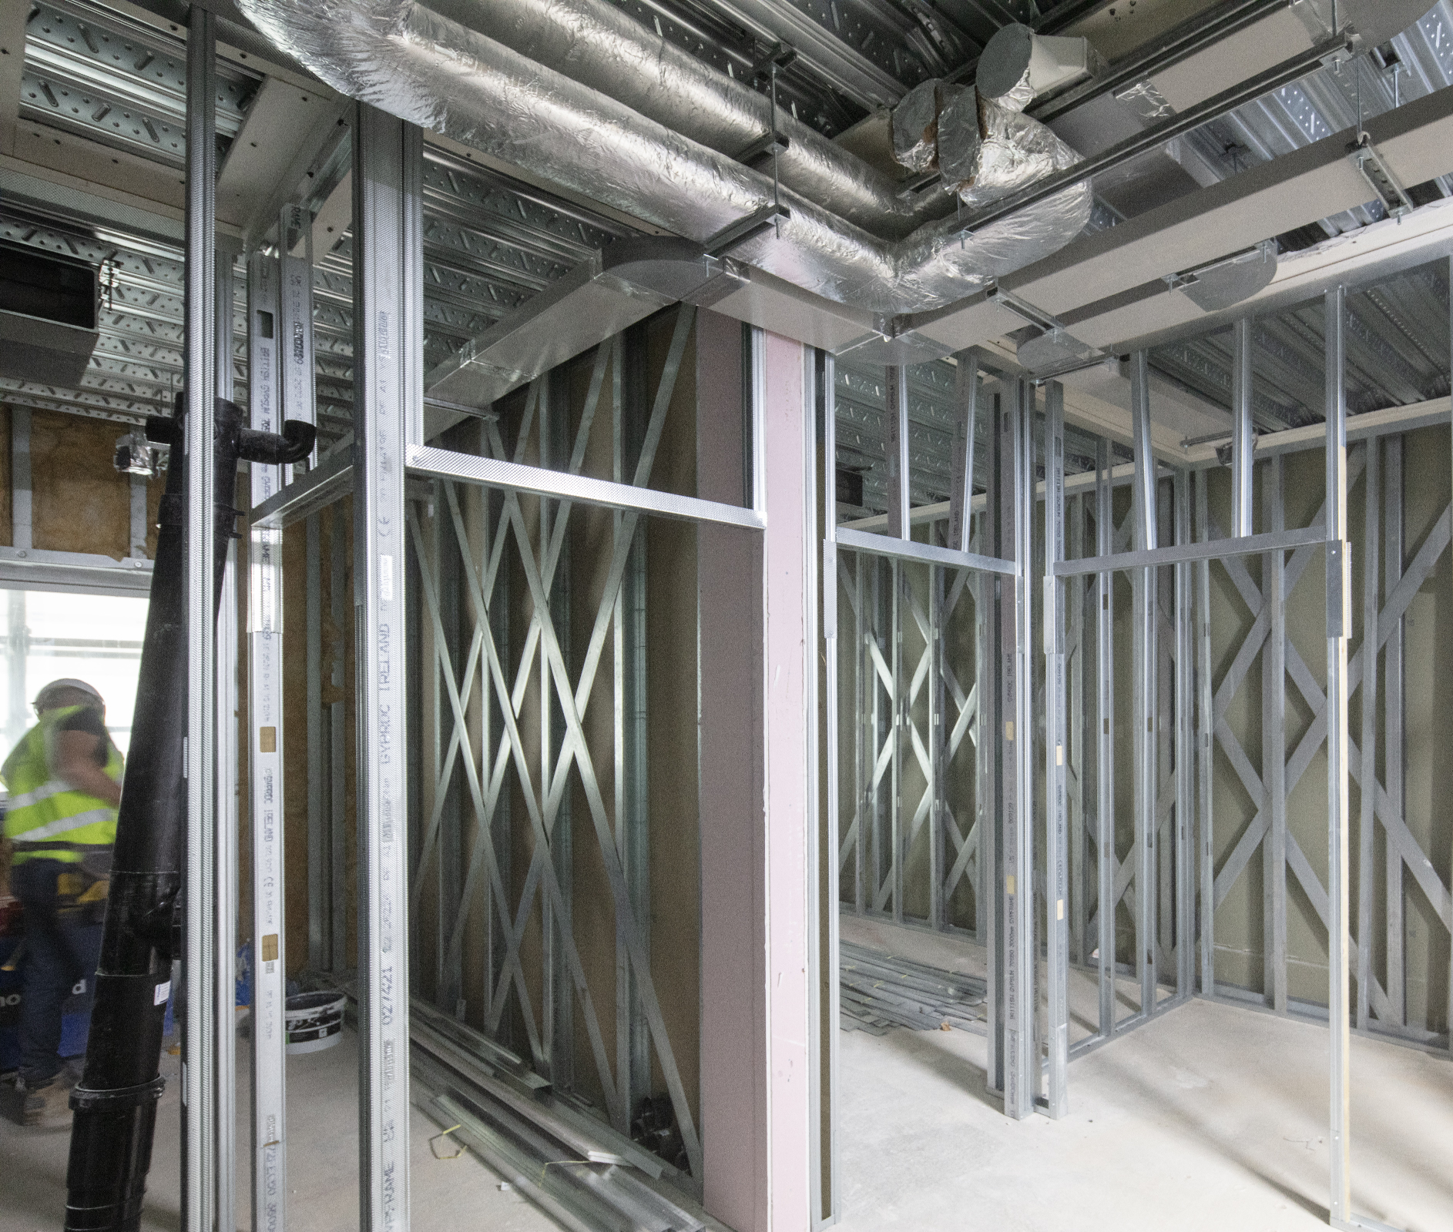
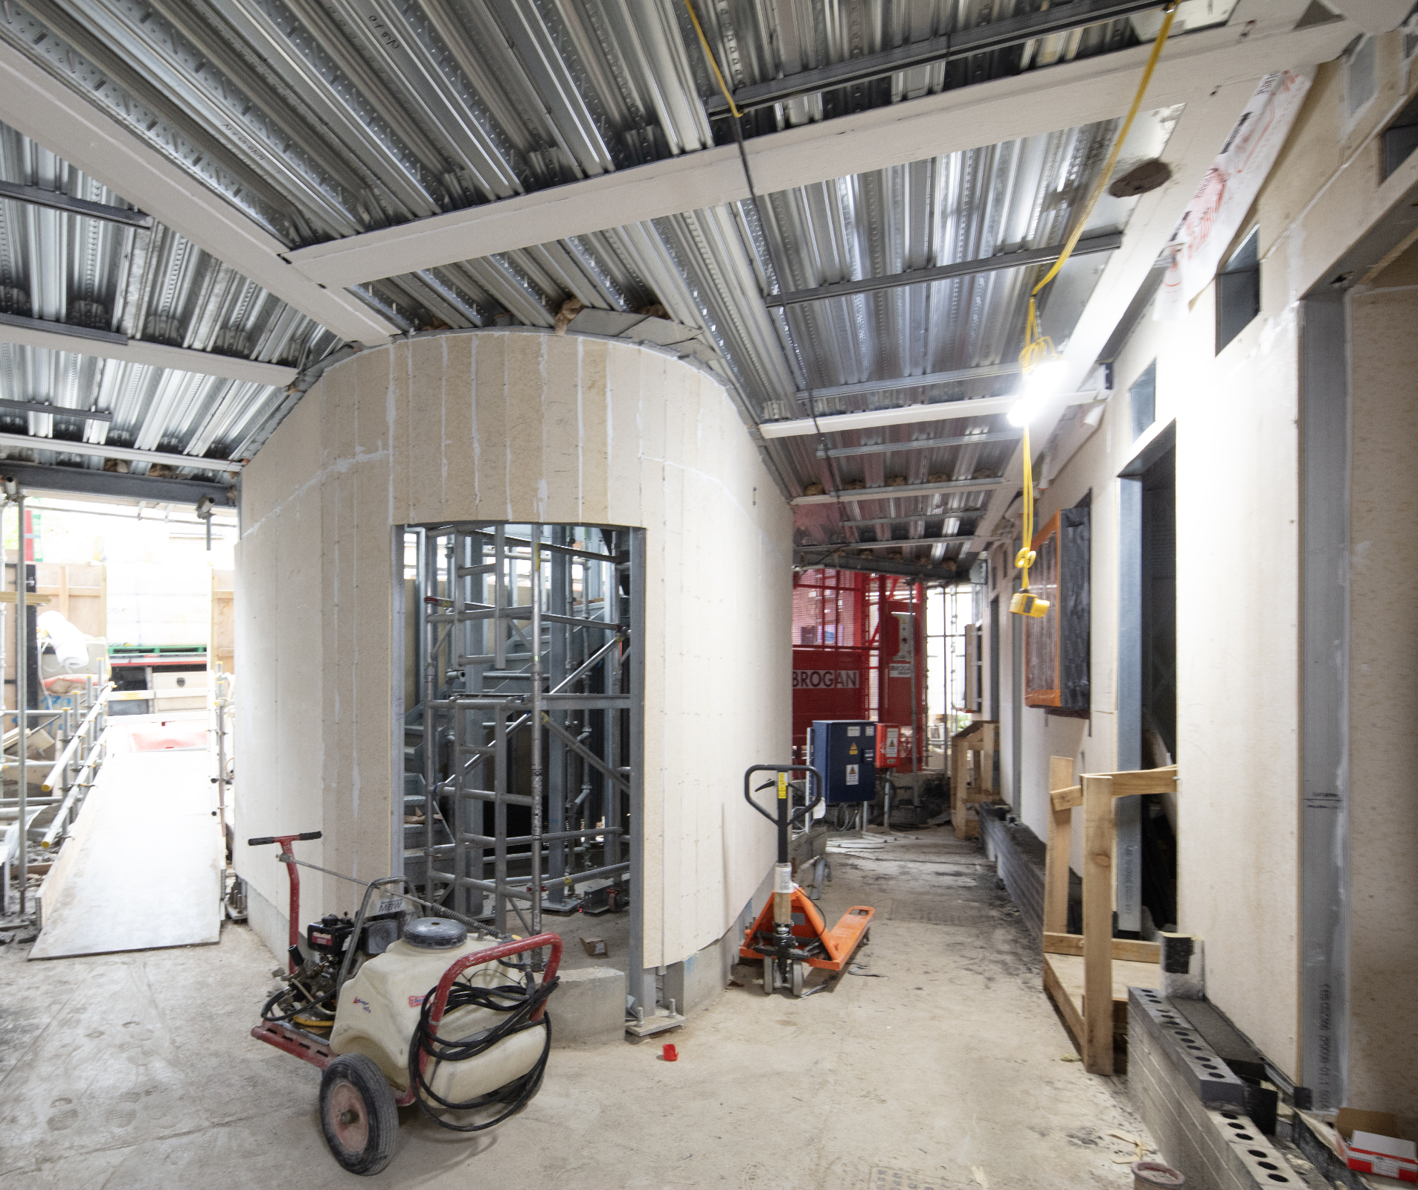
Progress On Site
Apartment & Staircase Progress
Notes:
Vision, Values & Purpose - expanded

Slide 9
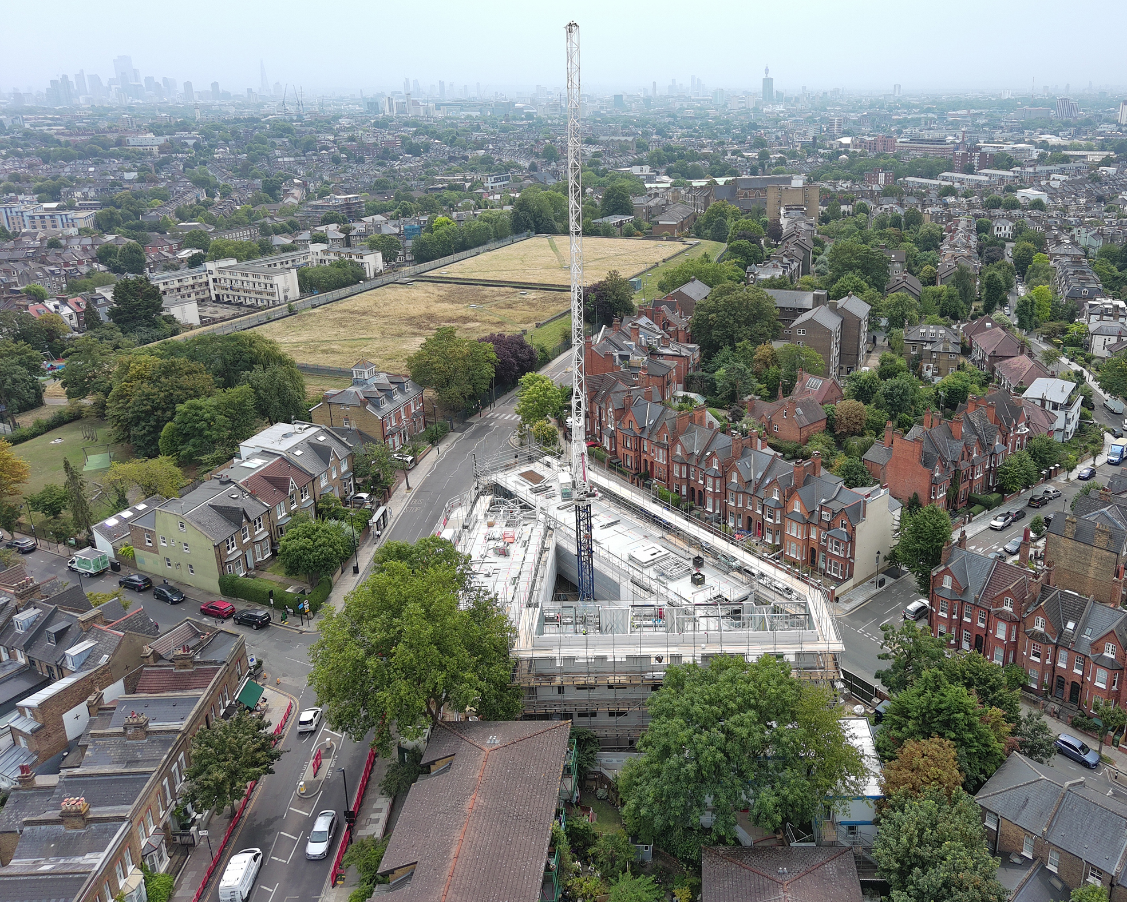
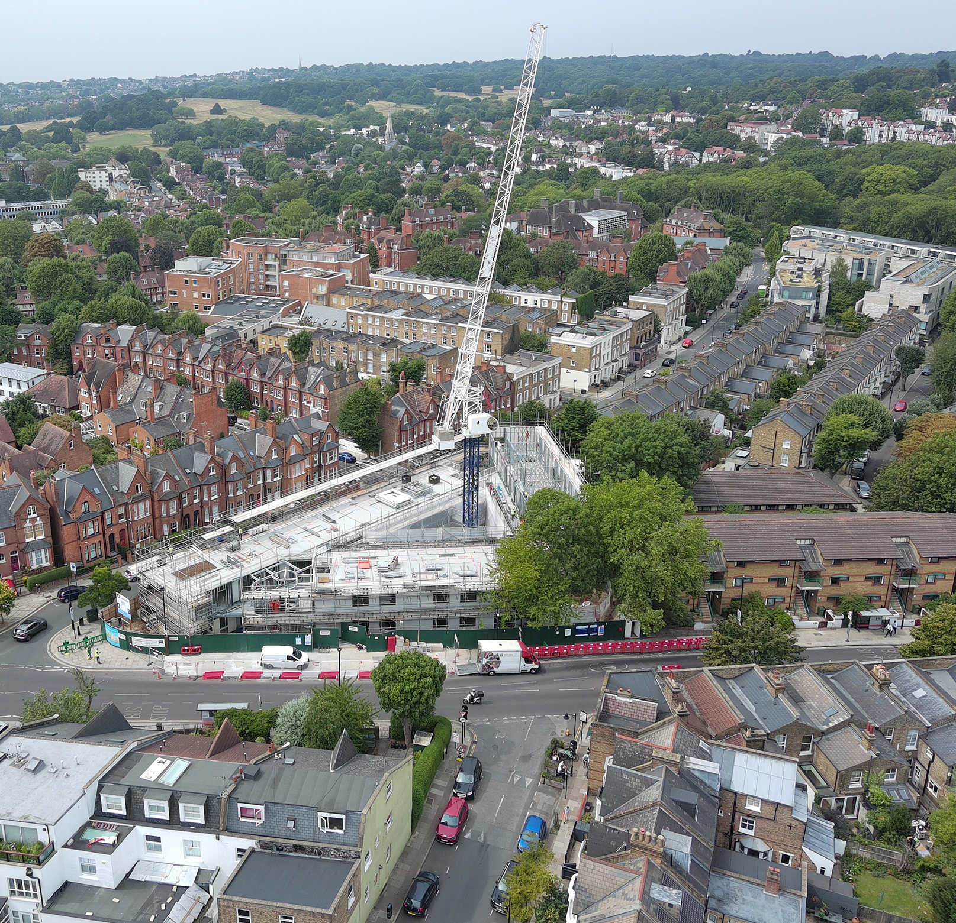
Progress On Site
Drone Footage from September
Notes:
Vision, Values & Purpose - expanded

Slide 10
Upcoming Works
Fitout – As the building becomes watertight, we will continue to progress with our internal fitout, building plasterboard partitions and installing the Mechanical and Electrical systems to the units.
Roof – As we approach the crane strike date, the roofing progress will be critical in to meet the deadline. PV Panels and Green Roofs will start to be laid over the next period.
Crane Strike – Currently scheduled for 10/01/26 & 11/01/26 (2 way traffic light on Dartmouth Park Hill – no full road closure)
Façade – The façade is now well underway. Insulation and Fire Barrier install is on-going, following the window install. Terracotta cladding will start to be installed over the next period.
Notes:
Vision, Values & Purpose - expanded

Slide 11
Social Value Update
Employment Skill Training:
Brickwork subcontractor appointed two apprentices from Camden.
Mechanical Electrical Plumbing subcontractor appointed an apprentice from Camden
We are currently recruiting for:
Carpentry Apprentice
Drylining Apprentice
Skilled Drylining Fixer
Contact Monica at Monica.Paul@morgansindall.com if interested in these vacancies.
Wider community engagement:
On the 19th of November, we are supporting a careers fair at Heath School (PRU – alternative provision).
We currently have a student from New City College, Kings Cross campus currently on a five-week placement with the Chester Road project team
47/47 CCS Score
Notes:
Vision, Values & Purpose - expanded

Slide 12
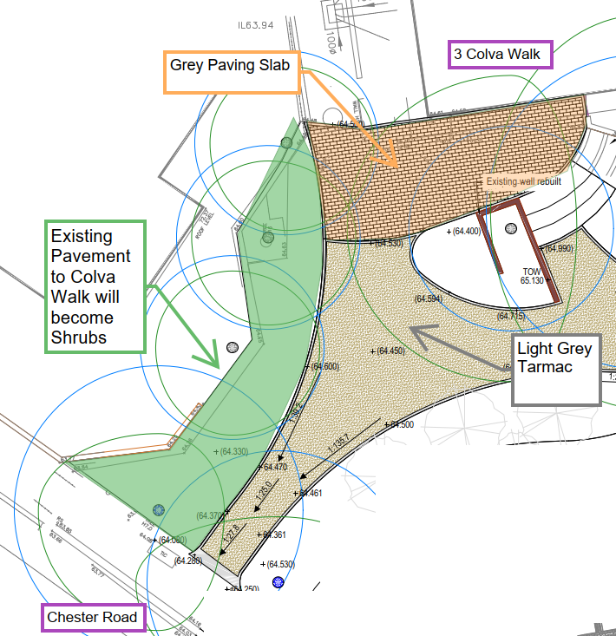
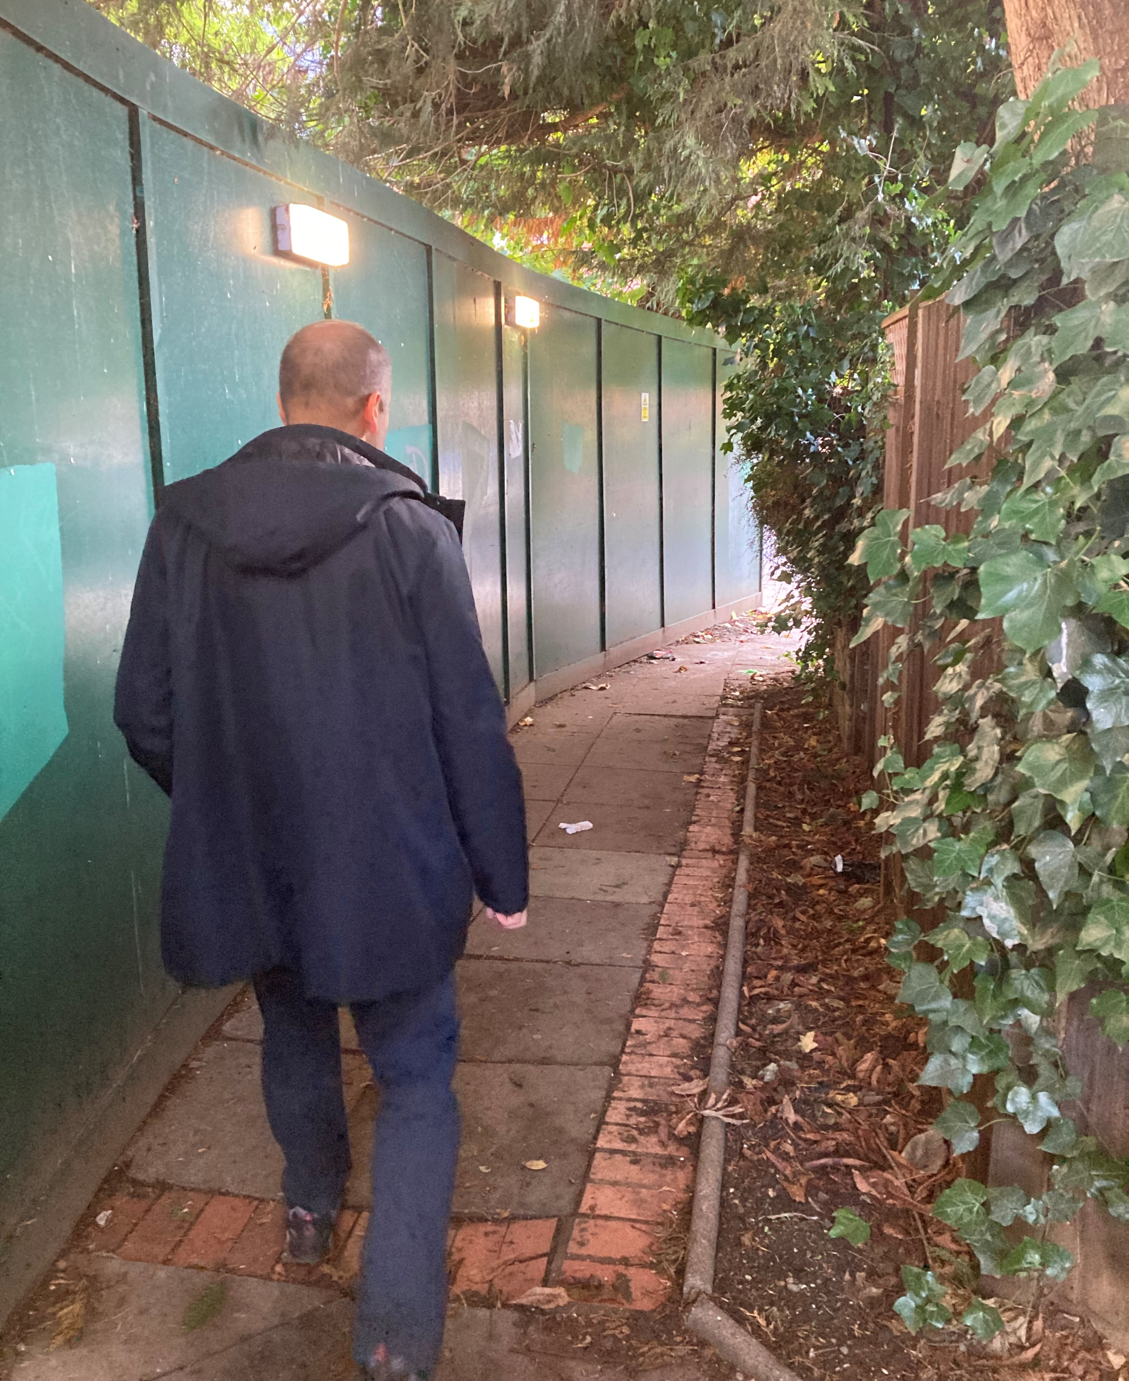
Colva Walk - Landscaping
Existing Colva Walk Footpath Walking towards Chester Road
Notes:
Vision, Values & Purpose - expanded

Slide 13
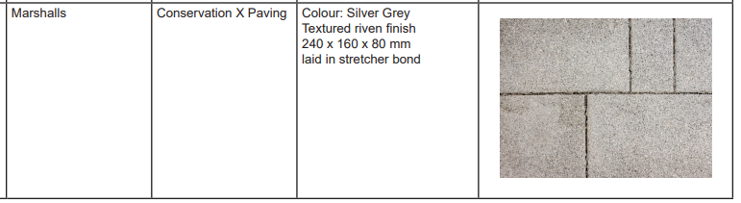
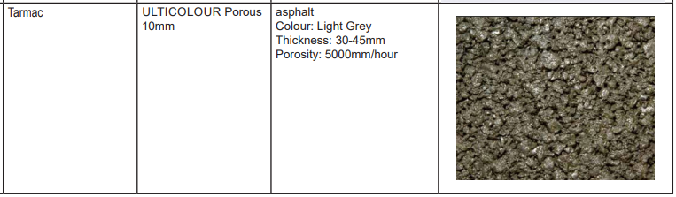
Sample Finishes
Notes:
Vision, Values & Purpose - expanded

Slide 14
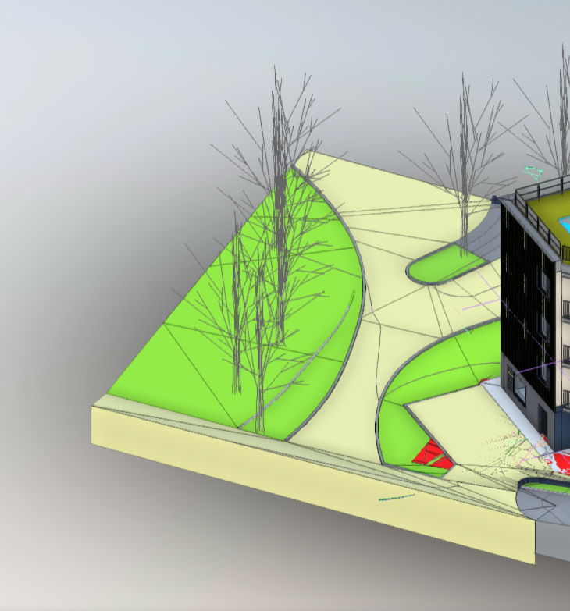
Colva Walk - Landscaping
The existing Colva Walk Pavement will be replaced with Shrubs and planting.
The new route will be moved further towards the new building, away from the trees on new tarmac
Not an accurate representation of how the final building will look
Notes:
Vision, Values & Purpose - expanded

Slide 15

Q
A
&
Notes:
Purpose statement

