Slide 1
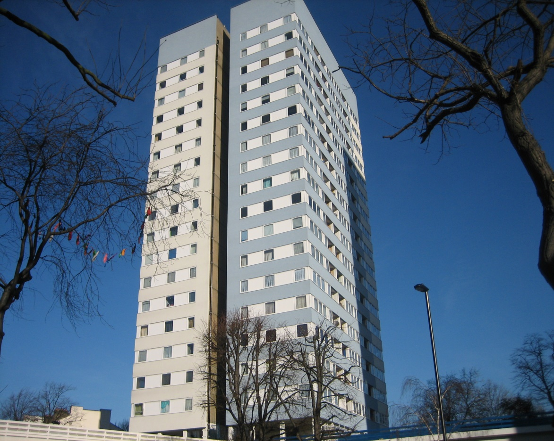
ABBEY ROAD HOUSING
CO-OPERATIVE
Presentation to Mary Green Residents
To join our Co-operative
By Francis Owusu-Sekyere
Estate manager

Slide 2
Who are we ?
Camden tenants and leaseholders of Abbey Road Estate managing our own homes.
Housing Law in England (The ‘Right to Manage’) gives Local Authority tenants right to take on the management of the Council Housing where they live.
When tenants join together to manage their own homes they set up ‘Tenant Management Organisation’ (TMO)
Our residents formed Abbey Road Housing Co-operative in 1992 and have managed their homes for over 26 years now
The group believed that they could provide a better and more cost effective service, like arranging repairs and estate cleaning than the Council.

Slide 3
Relationship with Camden
Abbey Road Housing Co-operative has entered into a Management Agreement with the LB Camden. The Management Agreement under the ‘Right to Manage’ Regulations sets out the responsibilities of the Council and that of the Co-op. This is legally binding
key responsibilities of Abbey Road Housing Co-operative
Repairs and maintenance up to £2,000 per repair
Management of void properties
Grounds Maintenance
Caretaking and estate cleaning
Tenancy and estate management
Lettings
General tenancy and housing advice
Financial management
Liaising with Council Officers on behalf of tenants and leaseholders
Key responsibilities of Camden Council
Maintenance of heating and hot water supply
Pest control
Lifts Maintenance
Entryphone system
Allocations
Capital and major repairs works
Aids and adaptations (i.e. due to disability)
Refuse collection
Allocation of Management & Maintenance Allowances
Rent Collection
Regulatory compliance

Slide 4
Who works for the Co-op ?
Governance
We have an active voluntary committee, who are elected each year at our Annual General Meeting (AGM). Our Committee includes tenants and residents in each block including three tenants from Mary Green. We also have several sub-committees, responsible for and accountable to the Management Committee for certain aspects of the Co-op’s work.
Our Committee and sub-committee structure is as follows:

Slide 5
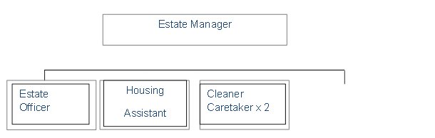
Who works for the Co-op ?
Staffing
The Co-op employs an Estate Manager who takes day to day responsibility for managing the estate and the services provided by the Co-op. The manager is also responsible for overseeing the work of staff.
The staffing structure of the Co-op is as follows:
Handyman
part-time
We also employ the services of part-time Bookkeeper, a Chartered Accountant and Auditors to ensure good governance, transparency and accountability. We also have access to professional legal advice and the Council Tenant Empowerment Officer.

Slide 6
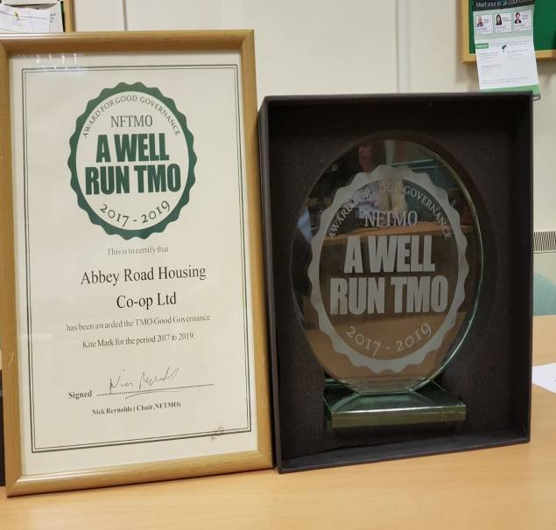
How have we performed ?
We continue to meet all of the requirements in the bi-annual, annual and 5 year reviews with the Council.
We receive on-going high levels of satisfaction from our residents.
In our last resident satisfaction survey conducted in July 2018, 93% of respondents said they were satisfied with the overall service received from the Co-operative.
ARHC were awarded the National Federation of Tenant Management Organisations (NFTMO) Good Governance KITEMARK in June 2017 following rigorous assessment of all operational areas. We are the only TMO in Camden and among the best in the country to achieve this prestigious award.
Exceed local expectations in the delivery of housing management services.
Continue to work with the Council to improve residents’ homes and the estate and adopt innovative approaches to secure funding to modernise tenants homes.

Slide 7
How have we performed ?
OUR PERFORMANCE
Actual expenditure compared with budgeted expenditure
96%
Training and development spend per Committee member
£468.60
% of Members enquiries dealt with within 10 days
100%
Invoices paid on time
99%
Visitors to the estate office
1646
Average time to re-let empty properties after major void works by Camden
4.5 days
Nuisance/ASB reports received 13
% Responded to within target
100%
Complaints received 03
% responded to within target
100%
Correspondence received 28
% responded to within target
100%
Residents’ satisfaction Survey Results Compared
 | Very Good/Good | Very Good/Good | Up/down
 | July 2018 | July 2017
Percentage of completed survey returned | 44% | 33% | up
Overall Service from Co-op | 93% | 94% | down
Value for money for services | 82% | 79% | up
Have you reported a repair in the last 12 months | 78% | 80% | down
Did we keep the repair appointment made | 93% | 86% | up
Were you satisfied with quality of repair | 84% | 81% | up
Quality of cleaning your block | 81% | 60% | up
Quality of estate cleaning | 82% | 69% | up
Contacted with the office in the last 12 months | 77% | 92% | down
Did you find the staff helpful | 97% | 96% | up
Were you satisfied with the final outcome | 94% | 94% | No change
Do we keep you informed | 97% | 99% | down
Do you read the Newsletter | 98% | 100% | down
Do you find the Newsletter Relevant | 96% | 94% | up
Total number of repairs received and attended to 390
% of repairs completed on target 99%
% of repairs completed at first visit 97%

Slide 8
What are the benefits to Mary Green residents joining the Co-op ?
Co-op residents demonstrated high levels of satisfaction and support for the Co-op by consistently voting overwhelmingly for the Co-op to continue to manage their homes and estate.
Locally established estate office less than 3 minutes’ walk from Mary Green.
Our staff attends to residents/other customers in less than 5 minutes when they come into the office.
We are a registered organisation with copy of our yearly audited account lodged with Financial Conduct Authority (FCA).
Joining our Co-operative will save Mary Green residents having to develop their own TMO with all the associated difficulties such as lack of Government funding for TMO development.
Knowledgeable and friendly staff with experience of managing similar properties just across the road. For example Mary Green Tower on Abbey Estate is similar to Snowman House and Casterbridge on ARHC estate.
In our July 2018 residents yearly survey, 93% said overall service from the Co-op was very good, and this provides assurance of further excellent service to Mary Green residents.
We pick up most phone calls in less than 5 rings.

Slide 9
Benefits to Mary Green residents contd
We provide excellent caretaking/cleaning services. We can confidently say our estate and blocks are clean based on regular feedback from residents.
We provide either same day or next day efficient repairs and maintenance service.
In Camden’s 2014 star survey, 94% of our residents said we kept our repair appointment.
We have our own grounds maintenance team. Residents are satisfied with the high quality level of their work.
We have access to DMC funds which Mary Green does not, owing to lack of a TRA on the estate.
We have low levels of anti-social behaviour and we promptly deal with neighbour disputes and household noise.
We organise community bonding activities for our residents and children including fun-days, coach trips to the seaside, Legoland etc.
Residents will benefit from our support, knowledge and experience in dealing with the Council and our multi-agency network.

Slide 10
What are the benefits to the Co-op residents ?
The Co-operative will increase in size to benefit from economy of scale in procurement.
Provide financial stability with potential reductions in future Management and Maintenance Allowances due to continuing financial pressure on the Council’s housing revenue account.
To maintain existing staff levels and employ additional staff.
Will enhance services provision to residents with cost savings.
Increased resident participation.
Maximising the use of IT and other office facilities.

Slide 11
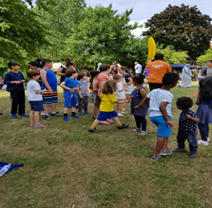
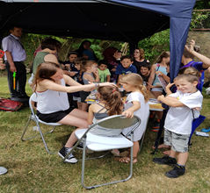
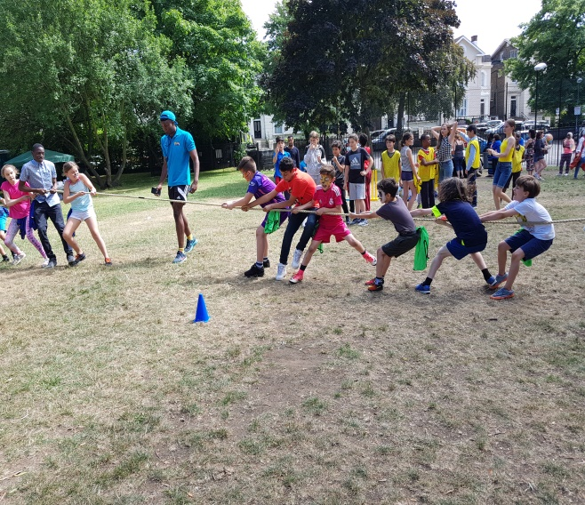
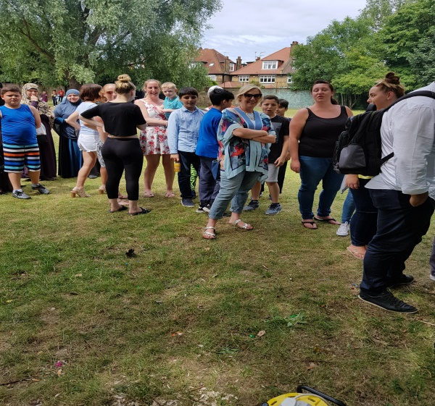
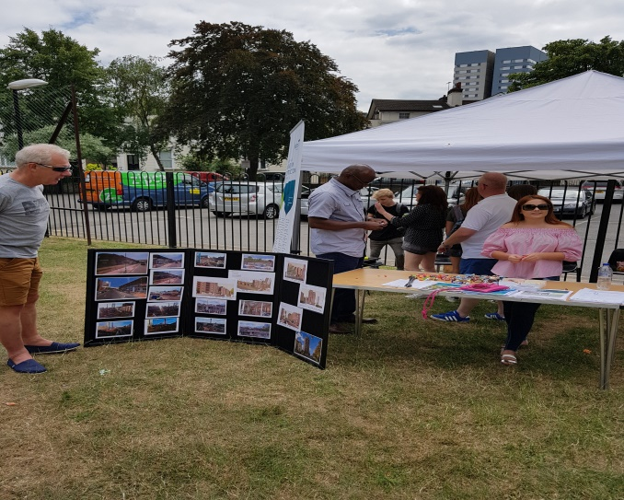
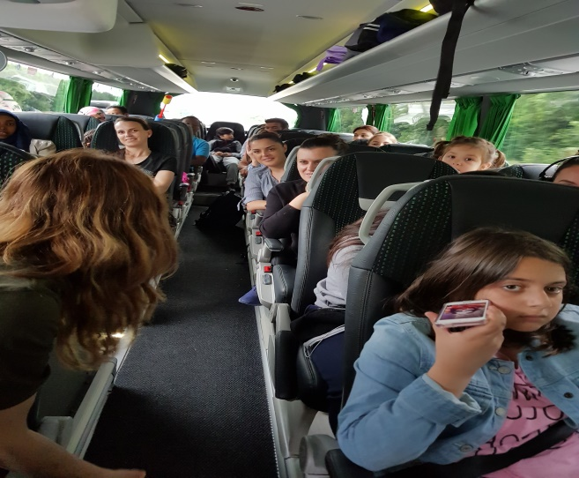
Resident participation.
25th Anniversary celebration in pictures

Slide 12
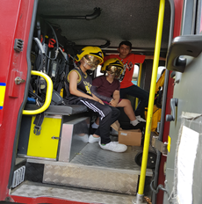
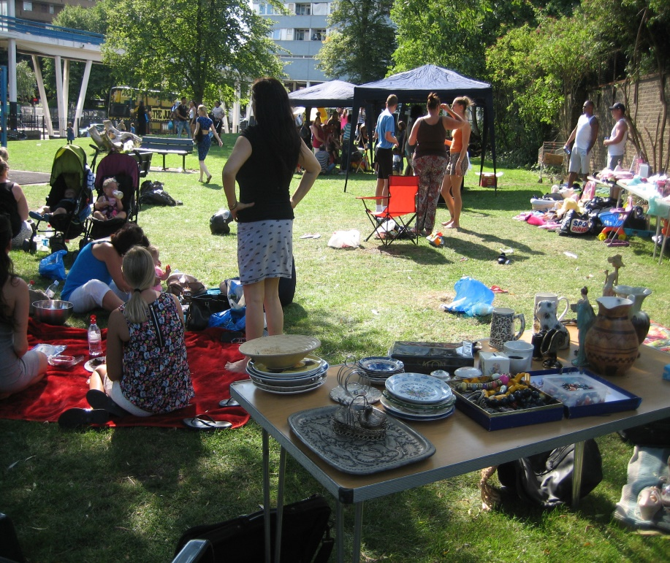
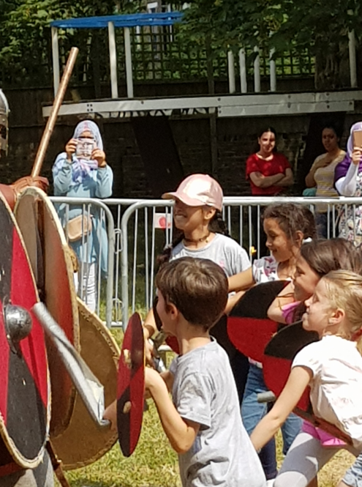
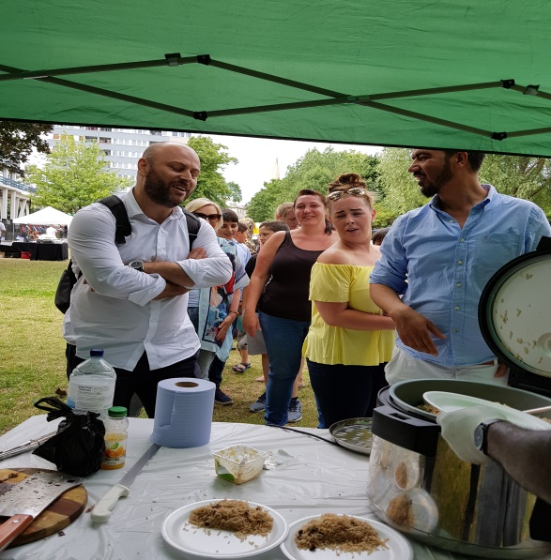
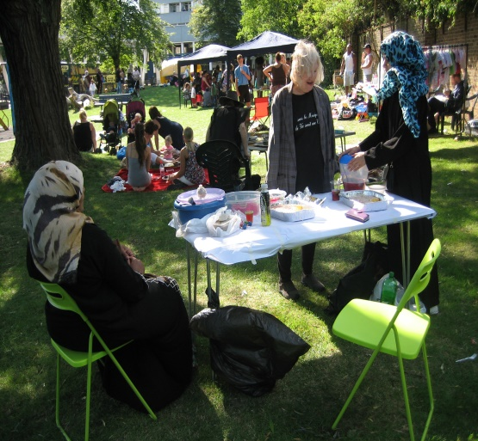
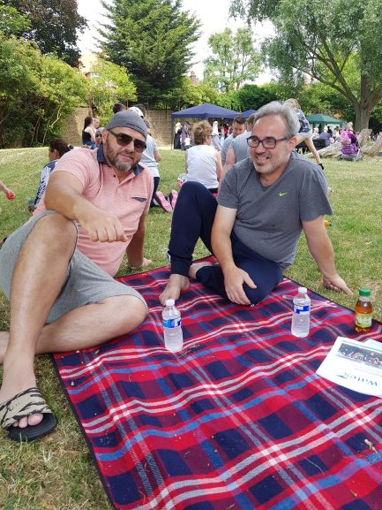
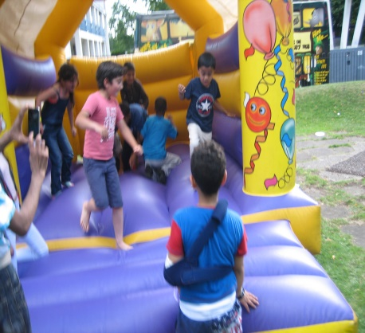
Resident participation
Summer on our Green

Slide 13
Improvement projects
New flooring of communal landings in Snowman House and Casterbridge and stairs in Emminster and Hinstock.
Fitted electronic gate to car park.
Refurbishment of tower blocks entrance lobbies.
Built bin chamber
Paving on the whole estate
Estate boundary fencing.
Estate park fencing
New blocks signage
Provided bicycle sheds
Children play area / equipment on the green
High satisfaction with in-house caretaking and repair services.
Visitors parking bays.

Slide 14
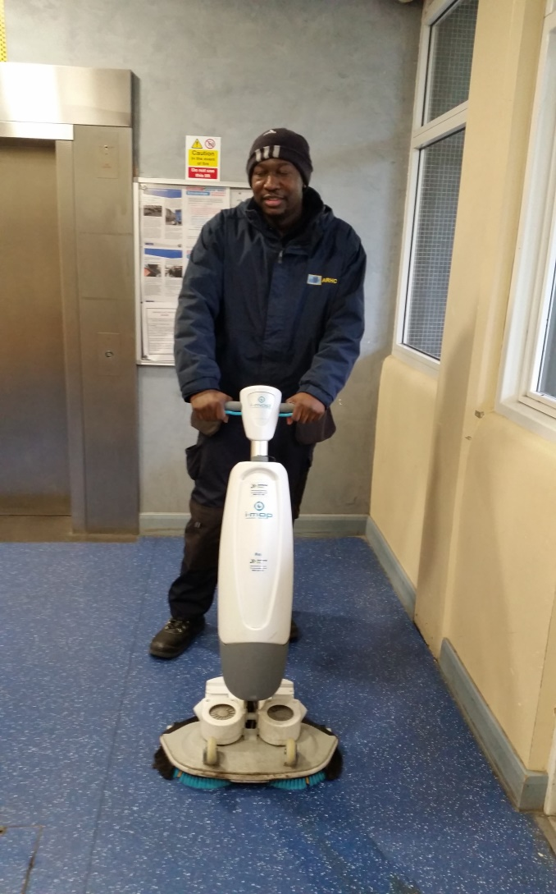
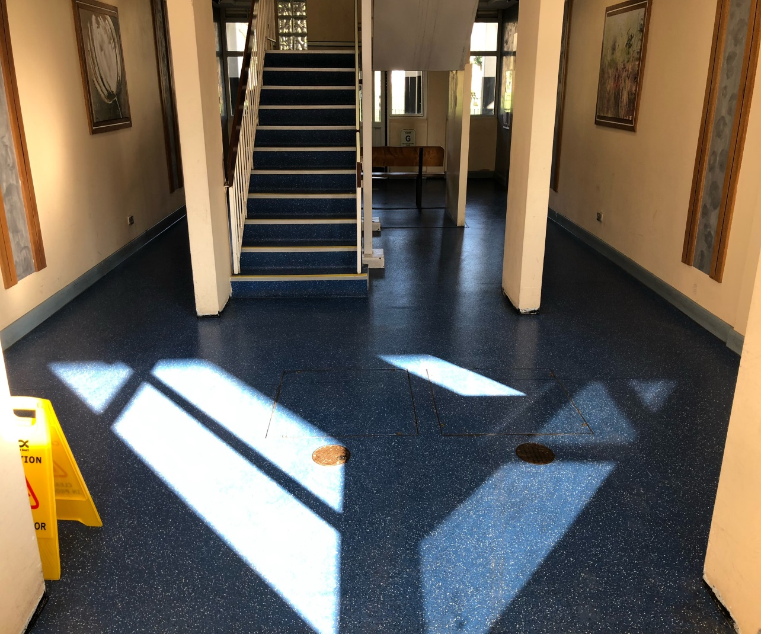
Improvement projects

Slide 15
Improvement plan for Mary Green.
Refurbish lobby area to the standard of Snowman House and Casterbridge lobbies.
Include Mary Green in negotiation with Regeneration team to remove Snowman and Casterbridge Garchey pits and connect to main sewage.
Install additional Noticeboards to improve communication.
To include Mary Green in the programme to repair and secure abandoned sheds on the second floor.
Develop large open space at ground floor to provide a bicycle shelter.
Develop empty rooms at ground floor for other community use.
Yearly satisfaction survey for residents, to decide service priorities.
To promote ease of access to staff and estate office.
Include Mary Green in our improvement programme to cover concrete back stairs.
Include Mary Green in our local lettings agreement with Camden for priority rehousing under regeneration.

Slide 16
YOUR POWER AS A RESIDENT
You have the opportunity at our AGM Yearly to vote to continue with the Co-op.
5 Yearly continuation ballot to either stay with the Co-op or return your management to Camden. Last ballot held in September 2018 – 94.2% voted yes.
Yearly resident satisfaction survey- Tell us what went right and wrong, and your priorities.
Opportunity to become a Management Committee member – free training available

