Slide 1
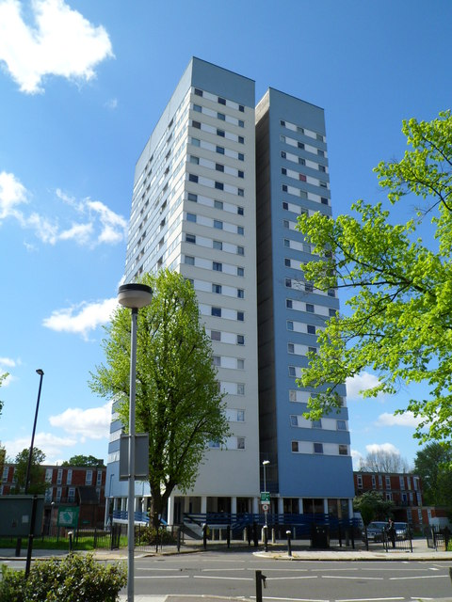
Housing Management
-
Mary Green
-
27th February 2019
Rosalind Lau – LB Camden
Ward Housing Manager

Slide 2
Current services…
Highlighted services:
Housing Management ( areas including ASB, tenancy issues etc)
Repairs
Caretaking and estate services
Other services:
Rents
Community safety
Allocations
Voids
Various support services (floating support/welfare rights/debt advice etc)

Slide 3
Why do a review?
It is recognised that to achieve the strong ambitions of Camden 2025, we need a more holistic way of working, a focus on tackling the root causes rather than symptoms of problems.
Emphasis is on prevention and early help
Ensure we are closer and more responsive to the needs of our residents
Ensure the service maximises resources and delivers efficiently

Slide 4
Reviewing the current service…
We gathered data, listening to over 600 resident queries through a range of avenues: phone calls, emails, complaints and drop in sessions.
What matters to our residents:
As a result, we defined the purpose of the Landlord Service as:
- Understand me & treat me fairly
- Fix my problem as soon as you can
- Keep me updated (in my chosen way)
- Be honest with me
Help me manage my money
Help me to keep my home & live peacefully
Give me clear and accurate information
HELP ME TO HAVE A SECURE, AFFORDABLE, SAFE HOME AND ENVIRONMENT THAT MEETS MY ONGOING NEEDS AND HELP ME WHEN I NEED IT

Slide 5
What does the new service look like?
A named Neighbourhood Officer allocated to a property.
‘One clear trusted point of contact’.
Responsible for managing all aspects of:
the rent account
neighbour issues including ASB
tenancy & leasehold matters
providing floating support
voids & lettings.
Focus is on prevention & early help.
The team also includes officers specialising in repairs, allocations, welfare rights and debt/money management.
The right skills, knowledge & experience in the team to meet and resolve residents needs.
Officer will pull in support and won’t refer or hand off
Implementation commencing Summer 2019.

Slide 6
Partner organisations & other agencies
Services under
1 roof
Benefits:
Joined up working
Less duplication of work
Linked in services
Sharing of information
Staff have range of knowledge & skills as a result.
Established relationship
Tenancy and leaseholder Services
Housing Allocations
Rents
Housing Benefits
Welfare Rights
Estate Services
Repairs
Voids
Housing Investigations
Courts Team
Tenancy and leasehold Services
Housing Allocations
Rents
Housing Benefit
Welfare Rights
Estate Services
Repairs
Voids
Housing Investigations
Courts Team

Slide 7
Repairs
Caretaking & Estate Services
Review of Repairs Service to ensure long term improvement to the service as a whole.
Right First Time (day to day) repairs - Satisfaction levels high at 93%.
Lessons to be learnt to improve service delivery for residents. Better communication, including open communication channels to facilitate feedback from residents.
Highly trained experienced workforce
Out of hours emergency call out available
Less staff turnover
Quicker response time
Improved efficiency & reduced costs
Enhanced flexibility
Local engagement & accountability
Highly visible
Currently going through a review.
Focus is on how we can improve your caretaking service and make sure that you are happy with how we look after where you live.

Slide 8
Accessibility
Contact Camden:
Camden residents can get in touch with the Council through Contact Camden:
visit us in person in 5PS reception, local offices & home visits
they can access services online 24/7 by registering for a Camden Account
phone us (24hr service for emergencies)

Slide 9
Thank you for listening ☺

